Slide 1





Data Visualization With & ggplot2
Case Study NYC Flights 2013
Prepared by : Aep Hidayatuloh
Email : aephidayatuloh.mail@gmail.com
GitHub : https://github.com/aephidayatuloh

Slide 2
{Prerequisite}

Slide 3
{Prerequisite}
Internet Connection
Software Installed:
R program [https://cran.r-project.org/]
RStudio [https://www.rstudio.com/products/rstudio/download/]
Data & Scripts:
Download from https://github.com/aephidayatuloh/introggplot2
R Packages:
ggplot2 : install.packages("ggplot2")
dplyr : install.packages("dplyr")
nycflights13 : install.packages("nycflights13")
Use install.packages(c("ggplot2", "dplyr", "nycflights13")) to install all those packages or simply install.packages(c("tidyverse", "nycflights13")) to install ggplot2, dplyr, nycflights13 and other useful packages.

Slide 4
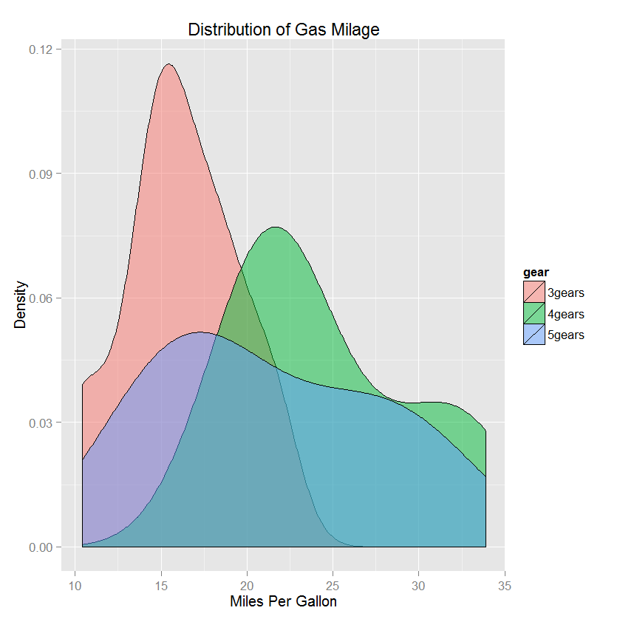
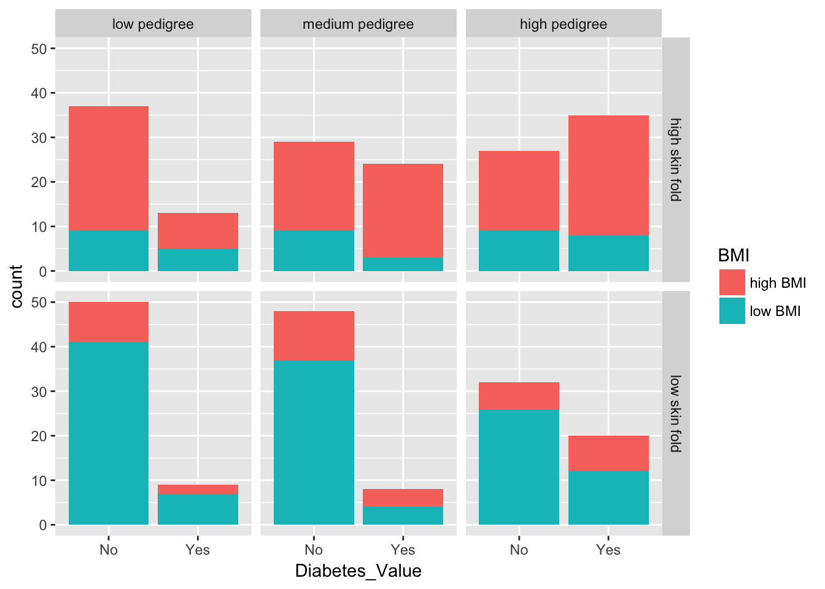
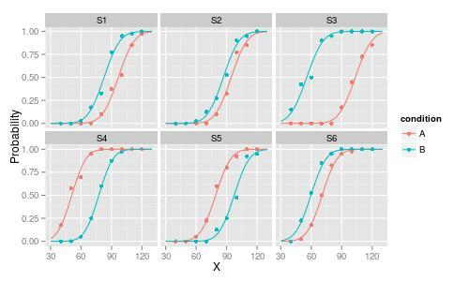
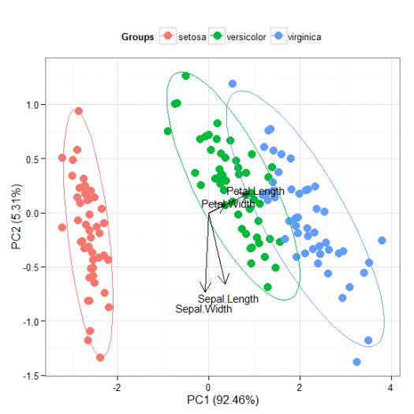
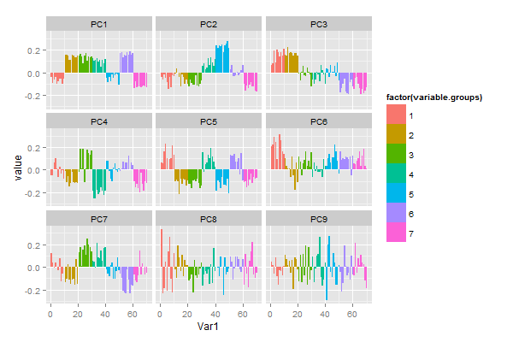
Have Seen Like This?

Slide 5

Have Seen Like This?

Slide 6
Objective
understand and able to create data visualization using R & ggplot2
Source and code can be downloaded from
https://github.com/aephidayatuloh/DataViz-Introggplot2
Reference
Wickham, H. 2016. ggplot2 : Elegant Graphics for Data Analysis Second Edition. Texas: Springer.
Grolemund G & Wickham, H. ____. R For Data Science. https://r4ds.had.co.nz.

Slide 7
Analytics
Analytics is the use of:
data,
information technology,
statistical analysis,
quantitative methods, and
mathematical or computer-based models
to help managements gain improved insight about their business operations and make better, fact-based decisions.

Slide 8
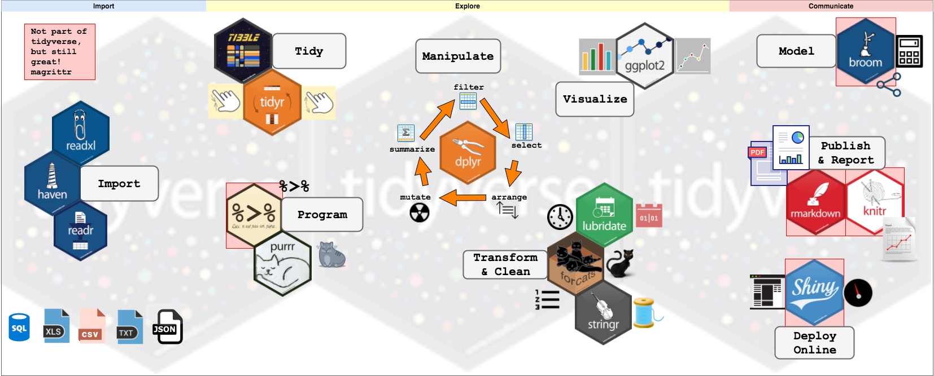
Tidyverse and Data Flow

Slide 9

The ggplot2, dplyr and pipe
Awesome Visualization
Great package for visualization in R
Powerful data management
Data manipulation and transformation in R became so easy
Pipeline in R
The dplyr imports this operator from another package (magrittr)
It’s the And Then

Slide 10
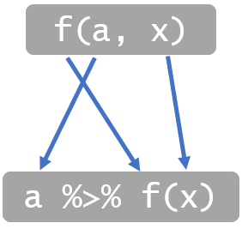
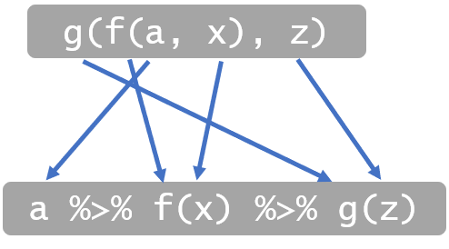
Understanding Pipe
# basic way
filter(
select(iris,
Sepal.Length, Sepal.Width, Species),
Species == "virginica")
# pipeline
Iris %>%
select(Sepal.Length, Sepal.Width, Species) %>%
filter(Species == "virginica")
“From Iris dataframe THEN
select Sepal.Length, Sepal.Width and Species column only THEN
filter which Species is virginica”

Slide 11
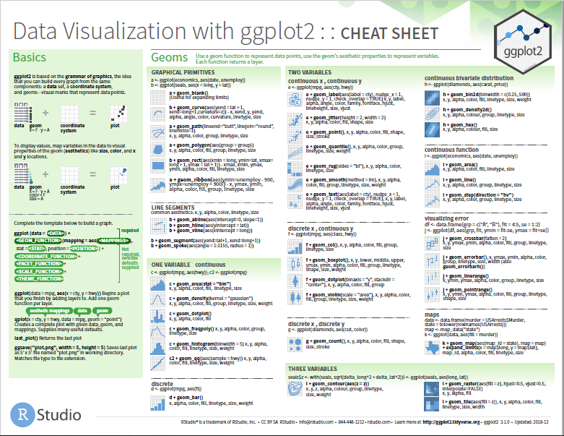
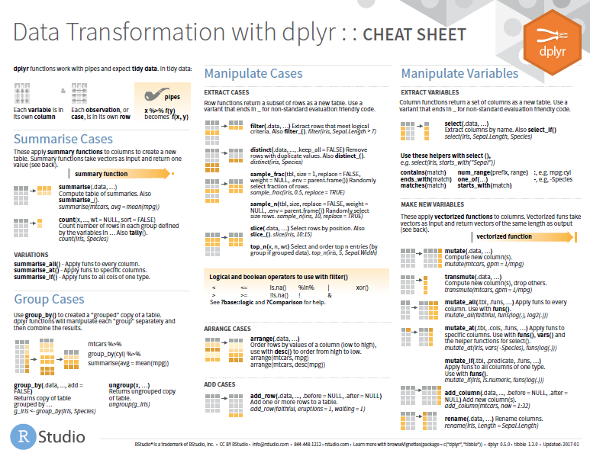
Cheat Sheets
https://www.rstudio.com/resources/cheatsheets/

Slide 12

Case Study
This data frame contains all 336,776 flights that departed from New York City (NYC) in 2013. The data comes from the US Bureau of Transportation Statistics.
flights
year
month
day
hour
flight
origin
dest
sched_dep_time
tailnum
carrier
…
weather
year
month
day
hour
origin
…
airports
faa
names
…
planes
tailnum
…
airlines
carrier
names

Slide 13
Lets {Code}!

Slide 14
{Excercise}!

Slide 15
??? {Q & A}

Slide 16
ThankQ

